Slide 1
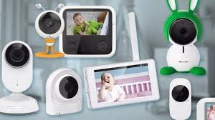
Lab #7
Apnea Monitor for Infants
Instrumentation, Usage, and Safety
By Socheath Sok

Slide 2
Background Information
(Causes, Types, Symptoms, and Treatments)
Apnea Monitors
Functionalities, and Safety
Products
Summary
References
Overview

Slide 3

Infant Sleep Apnea
Apnea: cessation of breathing
General Causes:
Neurological problems
Immature brainstem
Brain Infection
Part of another medical condition.
Lung disease, Metabolic disorder, Down’s Syndrome, etc.
Other: enlarged tonsils and adenoids due to inflamed and infected glands
[1] & [2]
Notes:
Infant sleep apnea is a breathing disorder that describe a condition when infants breathing slow down or stop completely during an infant’s sleep. the inability to circulate air and oxygen in and out of the lungs results in lowered blood oxygen levels. If this pattern continues, the lungs and heart may suffer permanent damage

Slide 4
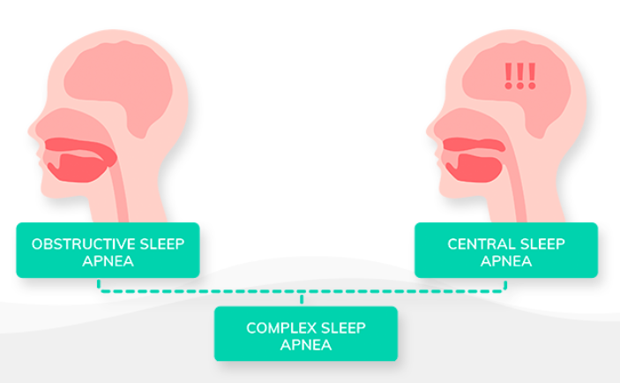
Types of Sleep Apnea
zzy
[4]
Notes:
This condition can happen to any infants but most commonly found in premature infants because of their underdeveloped respiratory center.your brain doesn't send proper signals to the muscles that control your breathing. the majority of apneas that occur in small premature infants are mixed apneas. Apneas that occur in larger premature infants and full-term infants tend to be central apneas. Obstructive sleep apnea is most commonly found in children between three to six years of age

Slide 5
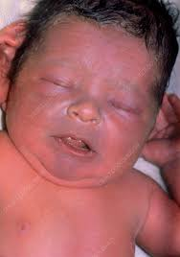
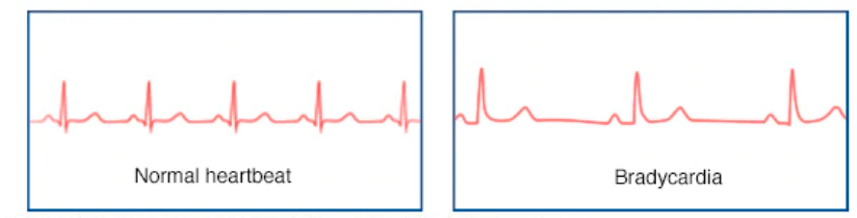
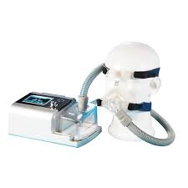
Symptoms:
Cyanosis Bradycardia
Treatments:
Drugs to stimulate the respiratory system. Ex: Aminophylline & Xanthine
Continuous Positive Airway Pressure (CPAP) ventilation
Home Apnea Monitor
[3]
Notes:
abnormal bluish discoloration of the skin, lips, and mouth vs unusually slow heartbeat,Loud snoring or noisy breathing, Restlessness during sleep
machine forces air through the tube at low pressure that is sufficient to keep the infant's upper airway open and to allow air to enter the lungs. Surgery?
For central sleep apnea, a home-based apnea monitor is usually sufficient, so its more commonly used and it will be the focus of my presentation.

Slide 6
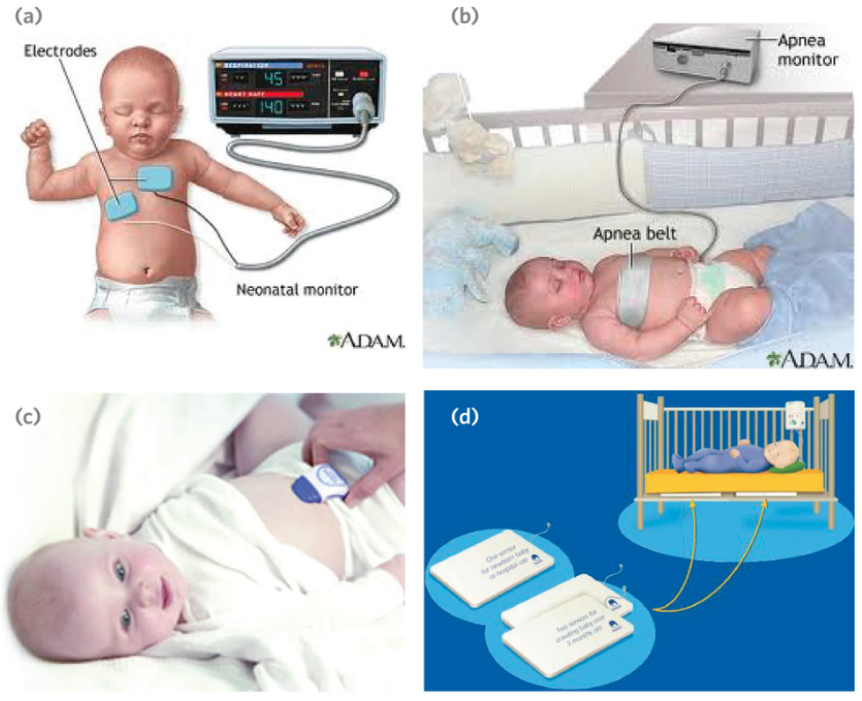
Infant Apnea Monitors
Notes:
Purpose : keep track of respiratory activity and heart rate. The device may also be referred to as an apnea and bradycardia or A/B monitor. Typically, the doctor will determine when and how often the baby needs to wear the apnea monitor.

Slide 7
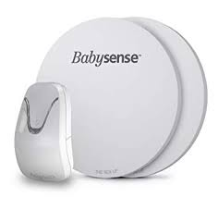
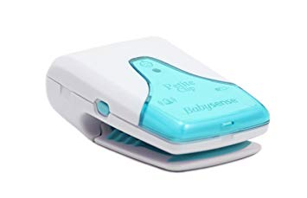
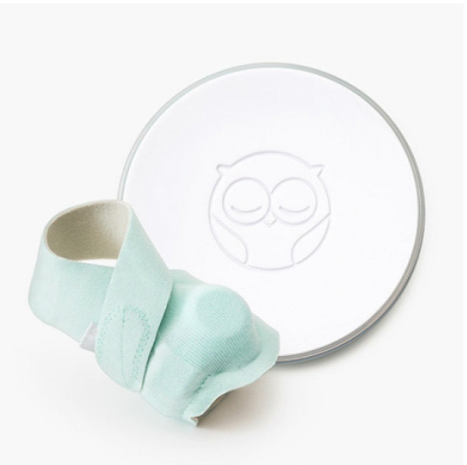
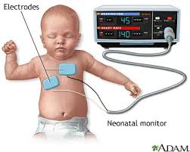
Types of Apnea Monitor
Movement Monitor
designed to alert you if the baby movements are absent or irregular for a preset time frame
Sensitivity can be set and fine tuned
Usually come in the form of sensor pads or devices that attach to the baby’s stomach or diaper
Cardiorespiratory Monitor
register chest movement and the heart’s electrical activity through electrodes
Using specially-made sensor to track your baby’s heart rate and oxygen levels
[5]
Notes:
There are a variety of breathing monitors available in the market today.. When it comes to Infant Apnea Monitor, there are 2 main types
set at a heart rate of 60 beats per minute for older babies and 80 beats per minute for a young one.

Slide 8


Safety
Do not place the monitor near your baby's head because alarm can be very loud and may damage your baby's hearing.
Keep the wires away from your baby's head and neck to prevent them from strangling your baby.
If the baby has stopped breathing, follow the instructions given to you by the healthcare provider.
If nothing work, perform CPR and call 911
Should not be used to reduce the risk of Sudden Infant Death Syndrome (SIDS)
[8]
Notes:
The American Academy of Pediatrics recommends that home monitors should not be used to reduce the risk of sudden infant death syndrome (SIDS)
The #1 leading cause unexplained death, usually during sleep, of a seemingly healthy baby less than a year old
Never shake your baby. This can cause brain damage.

Slide 9

Tips To Select Best Monitors
Identify the main features that the baby need
Offer extensive features for video and audio recording
Portable, easy to use, and reliable
No false alarms
In compliant with approved standards
High sensitivity and accuracy
Battery longevity, loudness, and area coverage
[7]
Notes:
In addition to monitoring different vital signs,

Slide 10
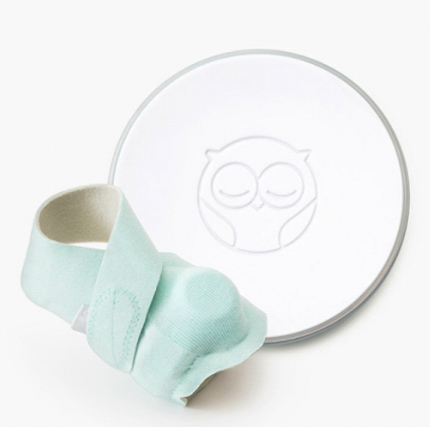
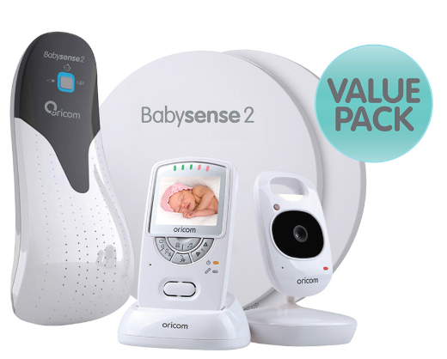
Companies & Products
Features: oxygen level, breathing, and heart rate
monitor, real-time monitoring app, rechargeable and portable unit, alert system
Price: $200
Owlet Smart Sock Baby Monitor
Features: video recorder, movement sensor
pads, temperature monitor, timer, and two ways audio, rechargeable unit, alert system
Price: $150
BabySense Video and Movement Monitor
[7]
Notes:
3 socks with the Smart Sock Sensor, batteries are lithium ion, 3 hours to charge Socks connect to the base via Bluetooth, the base station connects to your wifi and sends alerts to your phone.

Slide 11
Summary
When to use an Apnea monitor:
For babies and toddlers who have
ALTE (Apparent Life Threatening Event)
Resuscitation
Cyanosis
Sleep Apnea
Premature baby with:
episodes of breathing pauses
Bradycardia
chronic lung disease
How to pick a good device:
Choose a device that can monitor multiple vital signs
Offer additional features such as video and audio recording
Focus on sensitivity, accuracy, and reliability
Things to Remember:
Do not rely totally on the monitor
Do not panic
Review CPR and safety protocol
Notes:
In the end, it all depends on your needs. The prices usually depend on the features, as well as usability and portability.

Slide 12
[1] Kondamudi, Noah P. “Infant Apnea.” StatPearls [Internet]., U.S. National Library of
Medicine, 6 Mar. 2019, https://www.ncbi.nlm.nih.gov/books/NBK441969/.
[2] “Infant Sleep Apnea – Overview & Facts .” Sleep Education, American Academy of Sleep
Medicine,http://sleepeducation.org/sleep-disorders-by-category/sleep-breathing-disorders/infant-sleep-apnea/overview-facts.
[3] “Apnea, Infantile.” NORD (National Organization for Rare Disorders), 2007,
https://rarediseases.org/rare-diseases/apnea-infantile/.
[4]“Three Types of Sleep Apnea.” Goodsomnia Three Types of Sleep Apnea Comments,
https://goodsomnia.com/blog/snoring-sleep-apnea/sleep-apnea-types/.
[5] Knowlton, Erin. “Infant Apnea Monitor.” Coroflot, 23 June 2013,
https://www.coroflot.com/erinknowlton/Infant-Apnea-Monitor.
[6] Kaneshiro, Neil K. “Home Apnea Monitor Use - Infants: MedlinePlus Medical Encyclopedia.”
MedlinePlus, U.S. National Library of Medicine, 5 Sept. 2017, https://medlineplus.gov/ency/patientinstructions/000755.htm.
[7] Maheswari, Sumana. “7 Best Baby Breathing Monitors Available In The Market.”
MomJunction, Momjunction Momjunction FaceBook Pinterest
Twitter, 13 Sept. 2019,https://www.momjunction.com/articles/
baby-breathing-monitors_00355466/.
[8] “Home Apnea Monitor for Infants - What You Need to Know.” Drugs.com,
24 Sept. 2019, https://www.drugs.com/cg/home-apnea-monitor-
for-infants.html.
References

